Slide 1
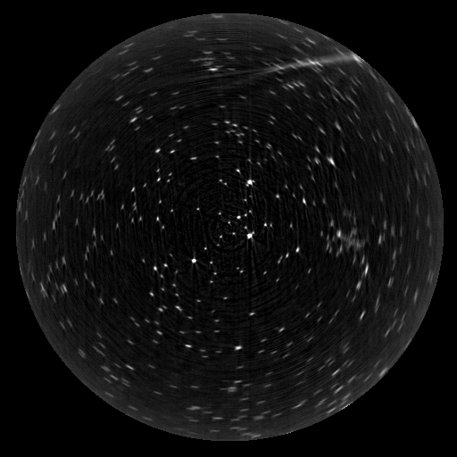
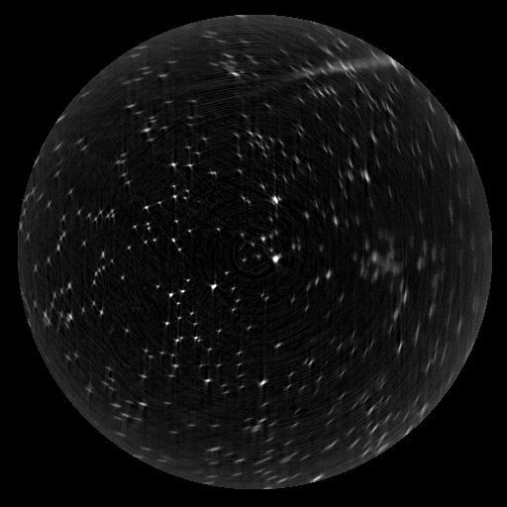
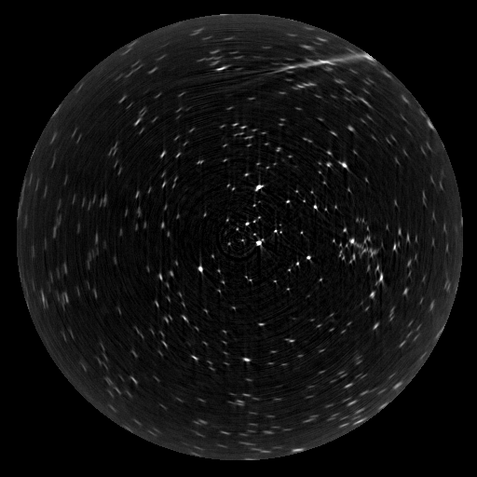
Scan 1
Scan 4
Scan 5
Notes:
Drive 2/Resolution tests/28.9.15

Slide 2
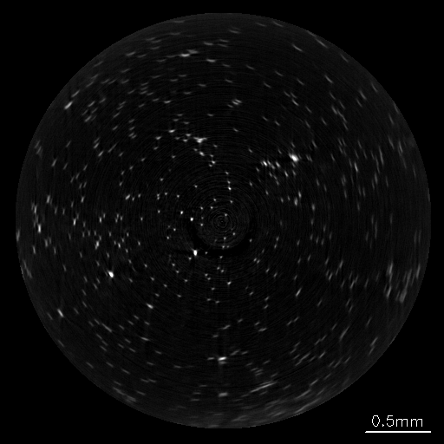
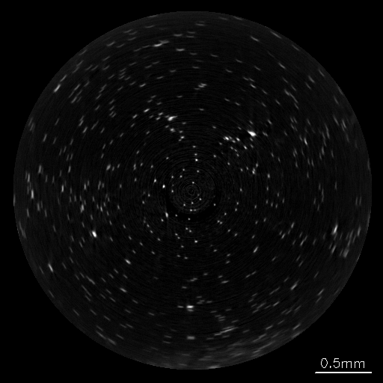
Scan 1
Scan 5
Depth of field
Notes:
Resolution tests 1.10.15

Slide 3
Off-centre
Depth of field
Depth of field
a.
b.
Scan 1
Scan 5
Notes:
Resolution tests 1.10.15

Slide 4
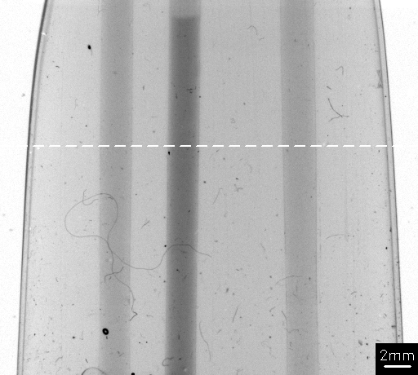
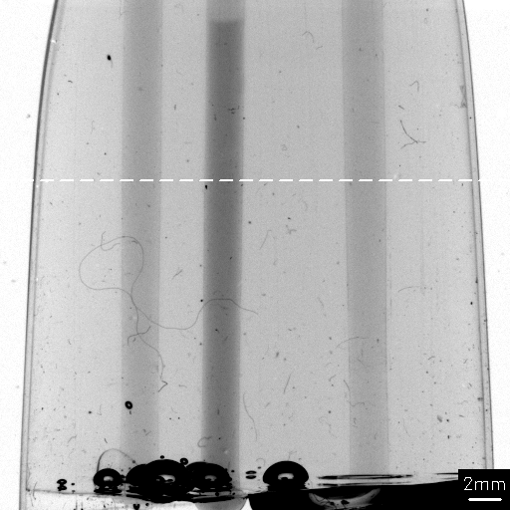
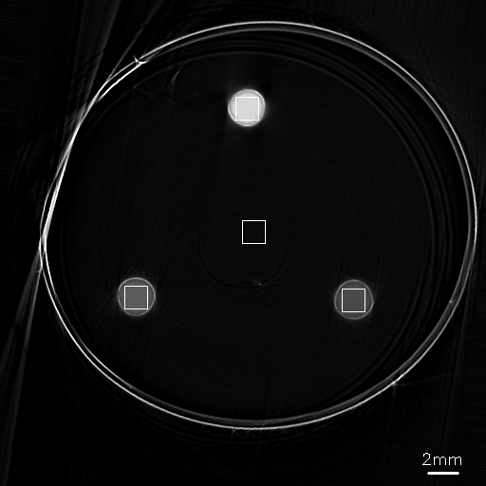
a.
b.
c.
Notes:
F:\Drive 1\Data\Gelatin\2_Rod_EB\recon_260-280.png
C:\data\Gels\EB_Rod_phantoms.xlsx

Slide 5
Matching tank
x
y
Depth of field
b.
Camera
j
Light source
Optical axis
Sample
Focal plane
Notes:
E:\Knife Edge MTF
E:\MTF microbeads\29.8.14\M1.6\scan 4

Slide 6
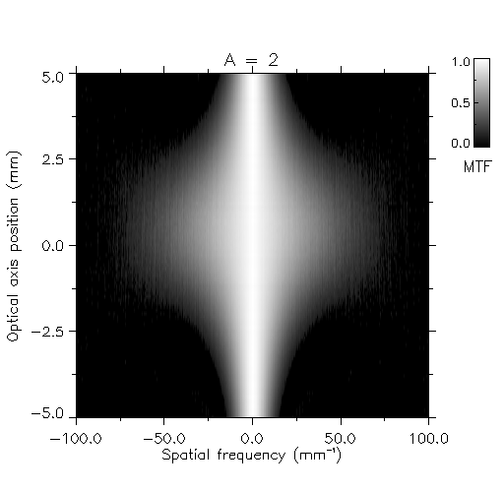
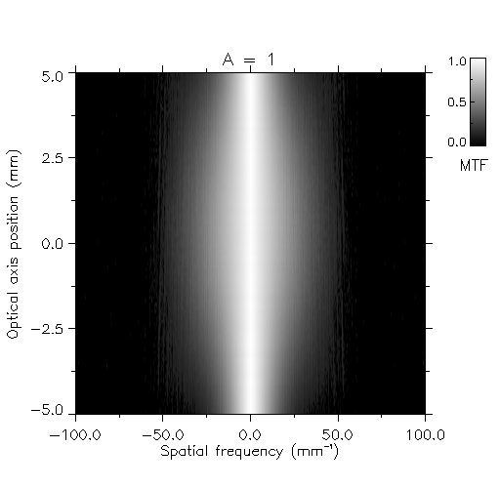
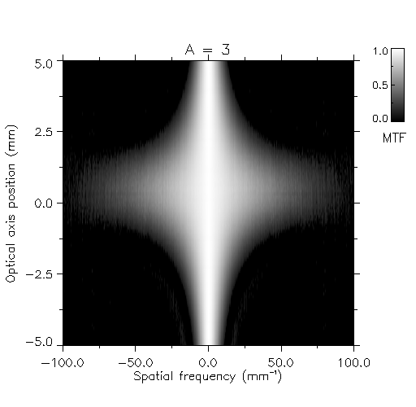
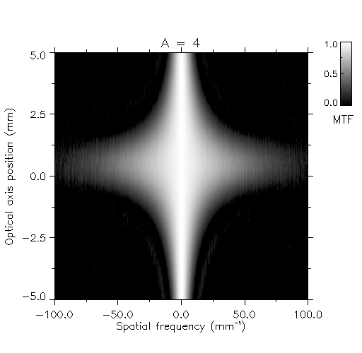
Depth of field
a.
b.
c.
d.

Slide 7
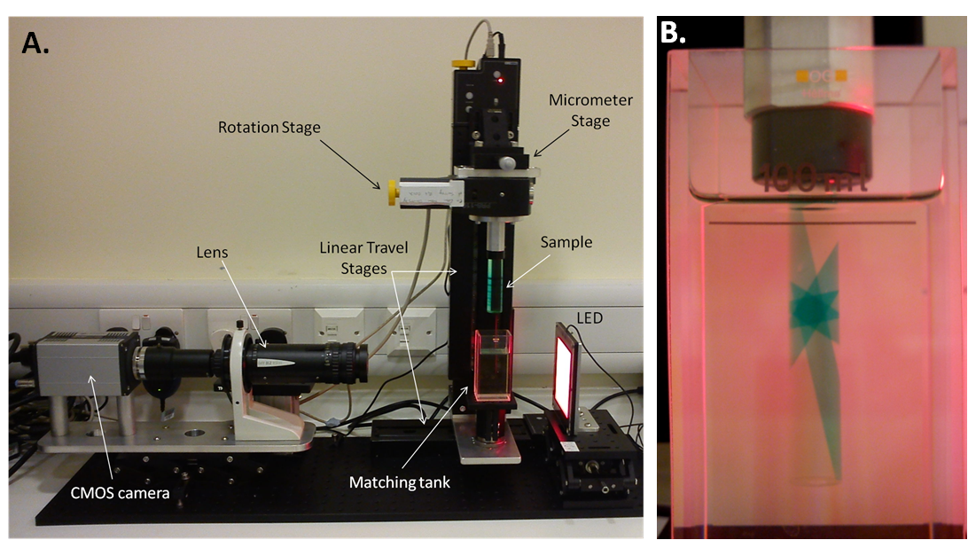

Slide 8
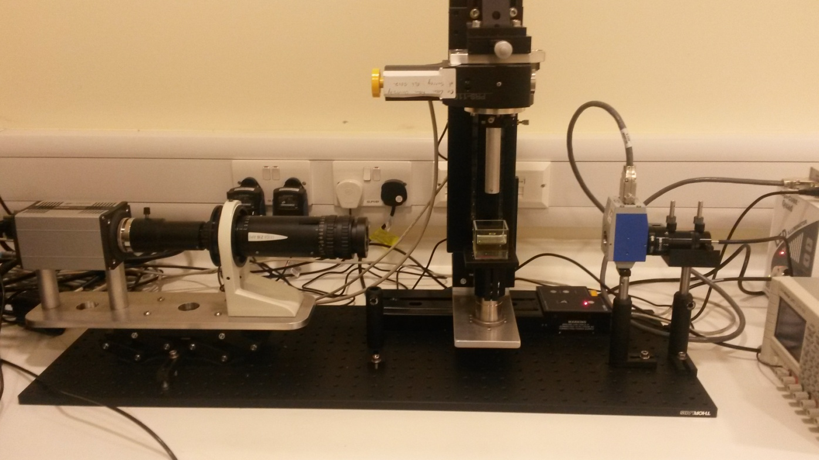
Additional positioning stages
Light Source
Sample Holder
Tunable Filter

Slide 9
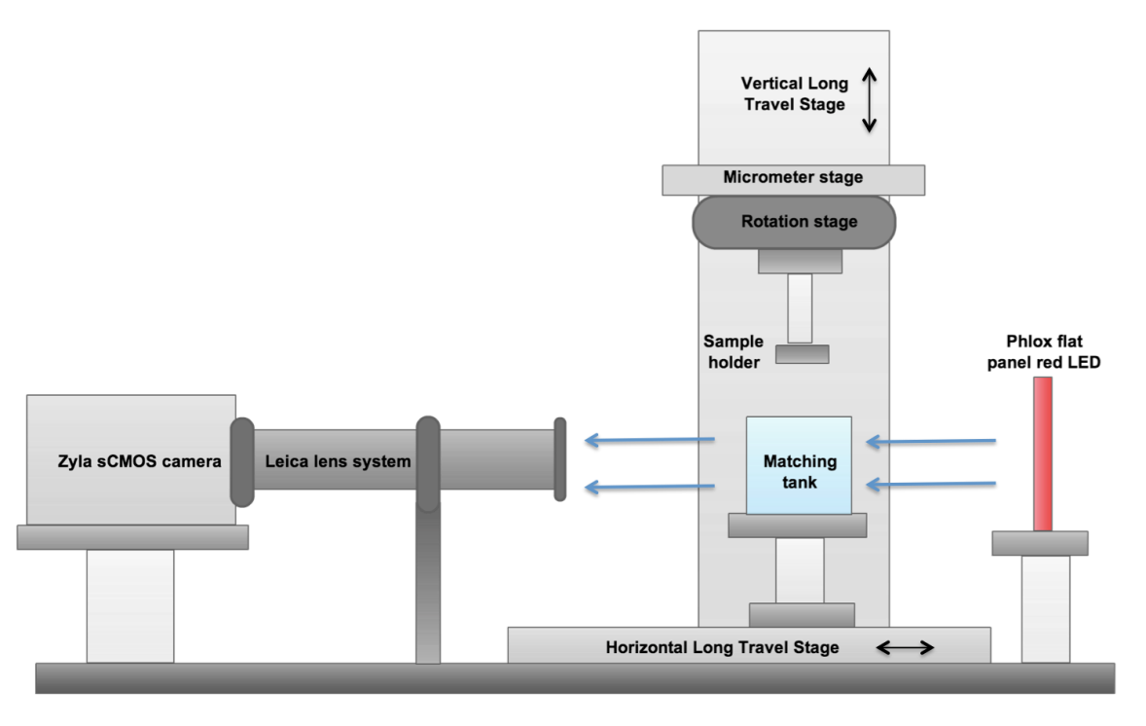
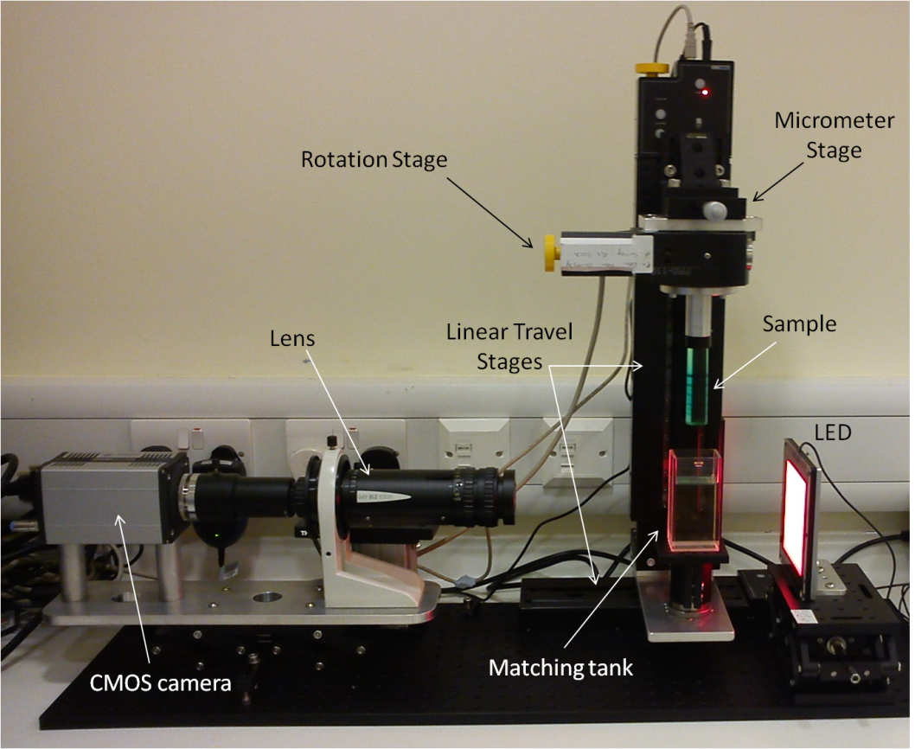
a.
b.

Slide 10
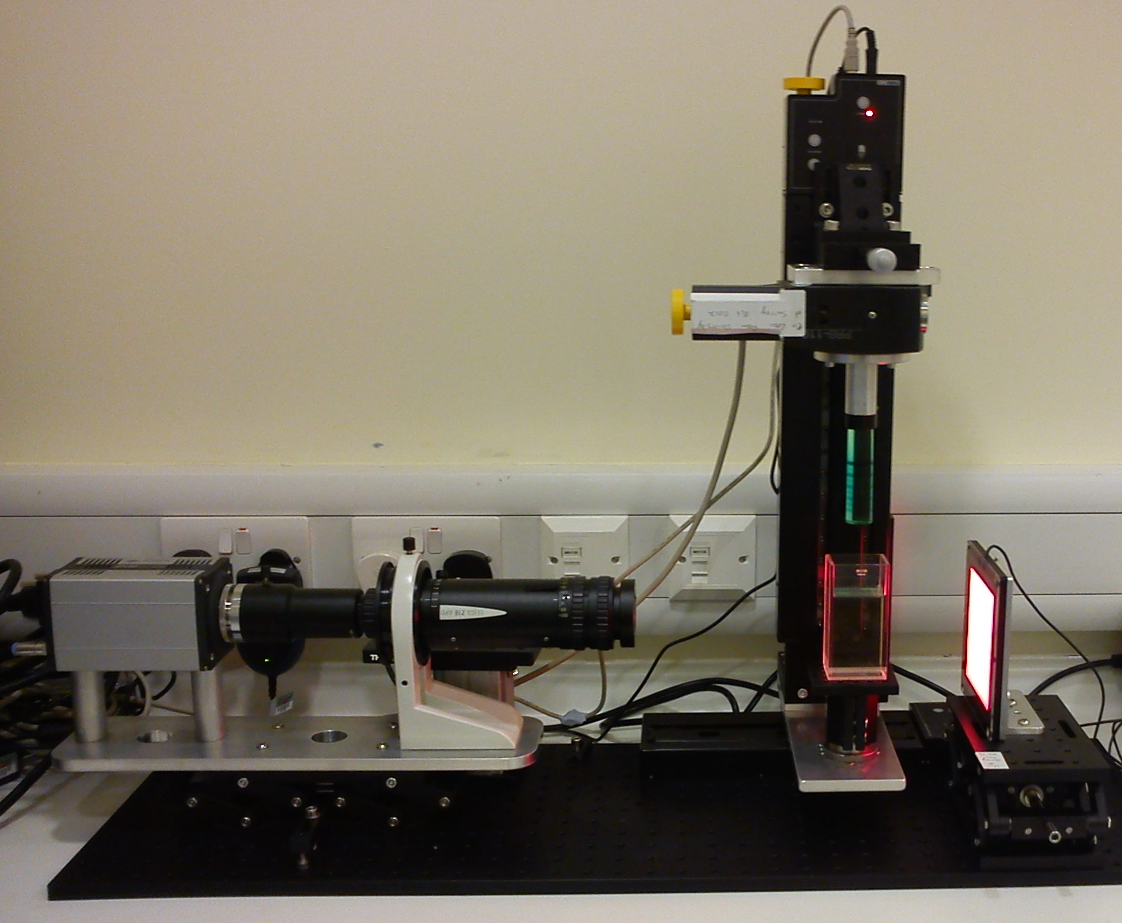
M
L
P
K
G
O
A
B
J
I
N
C
F
H
D
D
E

Slide 11
Tissue imaging set-up

Slide 12
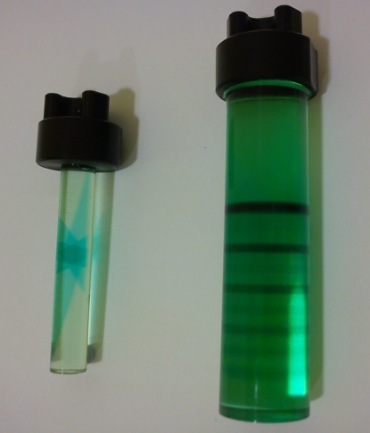
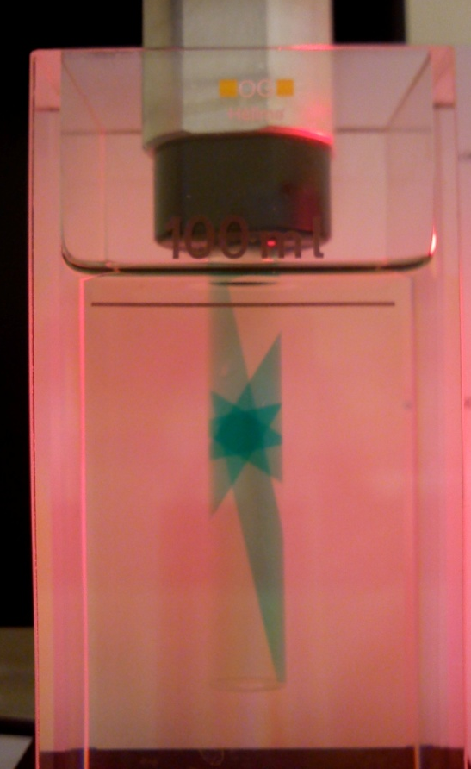
a.
b.

